Slide 1
ML Model Lifecycle

Slide 2
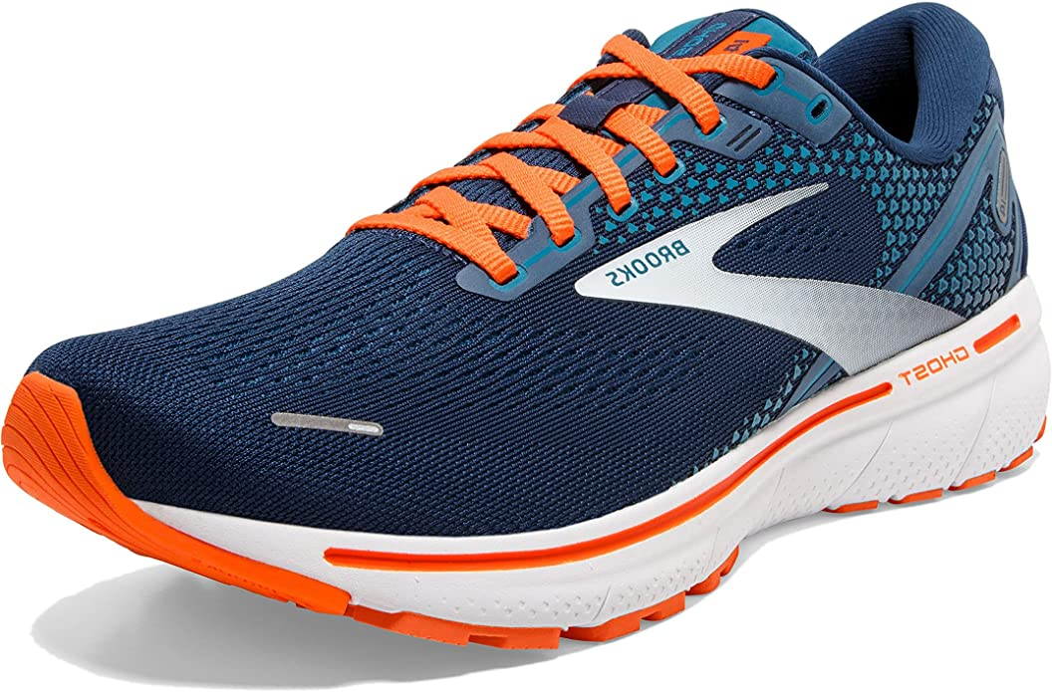
Running shoes
lifecycle?

Slide 3
01
Provide
Generally, it looks like that…
Design
02
03
Improve

Slide 4
01
Release
In IT it may look like that…
Develop
02
03
Operate

Slide 5
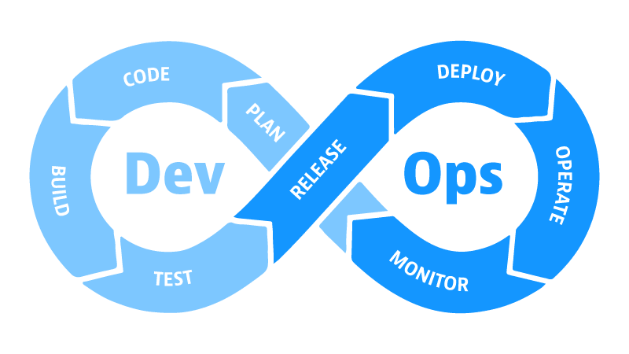
Or, like that…

Slide 6
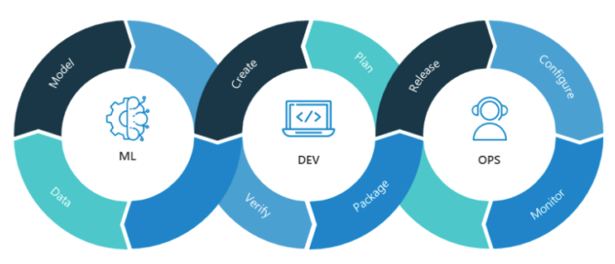
Or, like that…

Slide 7
01
Deploy
ML World is quite similar
Develop
02
03
Monitor

Slide 8
Retraining trigger
01
Deploy
Model
Each stage generates some artifact or signal
Develop
02
03
Monitor
Prediction service

Slide 9
experimentation/dev/test
01
Deploy
Develop
02
This is a code ☺
03
Monitor
staging/preprod/prod
01
Deploy
So, we want to treat it in a DevOps way
Develop
02
03
Monitor

Slide 10
01
Deploy
Each stage may be easy. Or complex…
Develop
02
03
Monitor

Slide 11
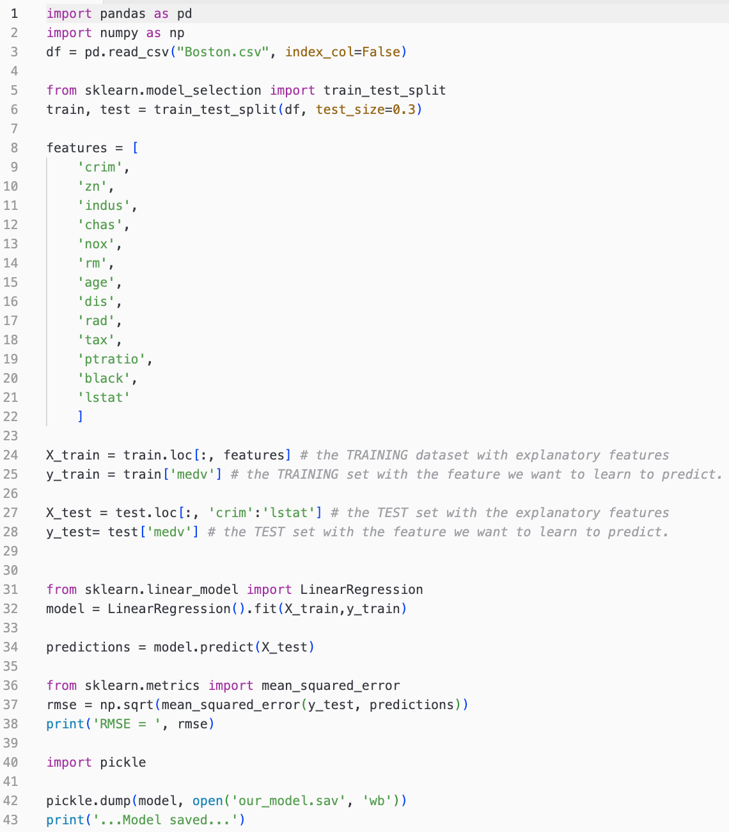
Easy

Slide 12
A bit more complex…
Raw data
Data extraction and analysis
Data preparation
Model training
Model evaluation and validation
Trained model

Slide 13
Raw data
ML
Data extraction
Data analysis
Data preparation
Model training
Model evaluation
Model validation
Trained model
Model registry
Performance monitoring
Prediction service

Slide 14
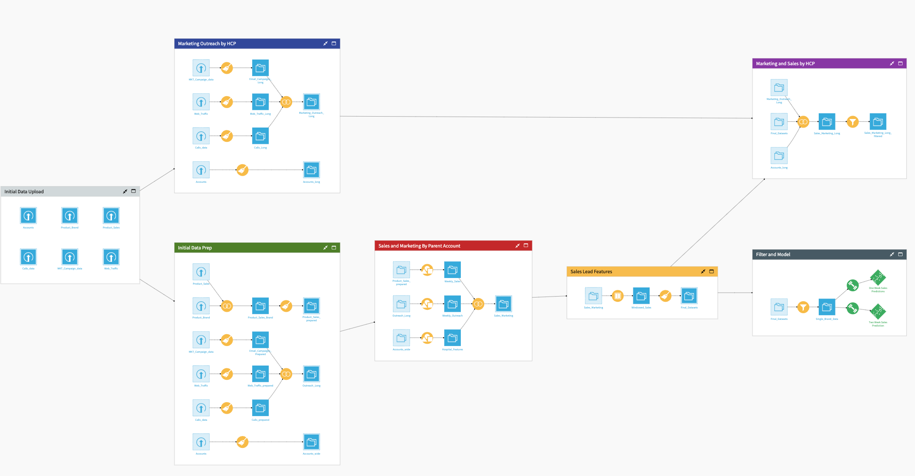
Want sth real???

Slide 15
ML Pipeline consists of artifacts and components
Artifacts
Raw data
Data extraction and analysis
Data preparation
Model training
Model evaluation and validation
Trained model
Components

Slide 16
Components „do” things
Model training
Remember WBS?
Work Breakdown Structure

Slide 17
Artifacts are the „things”
Trained model
Remember PBS?
Product Breakdown Structure

Slide 18
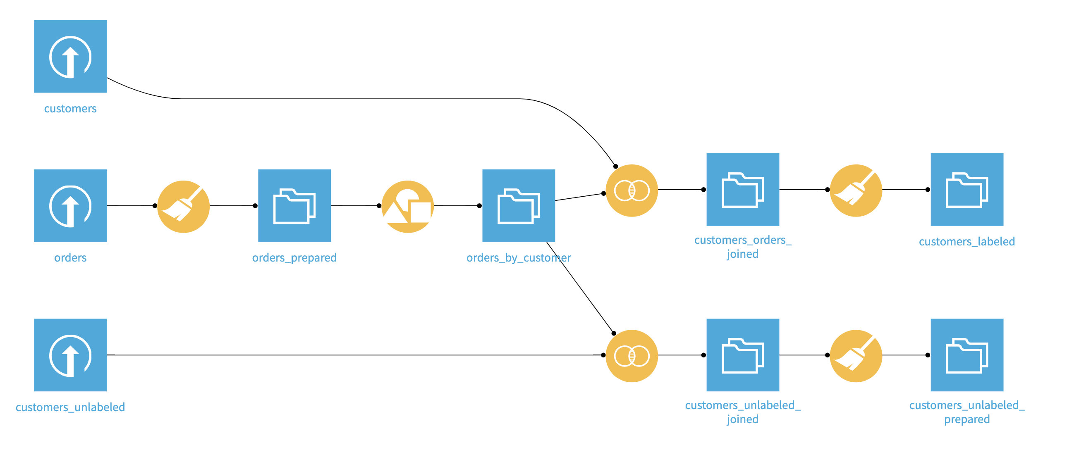
That’s often visualised in an ML pipeline

Slide 19
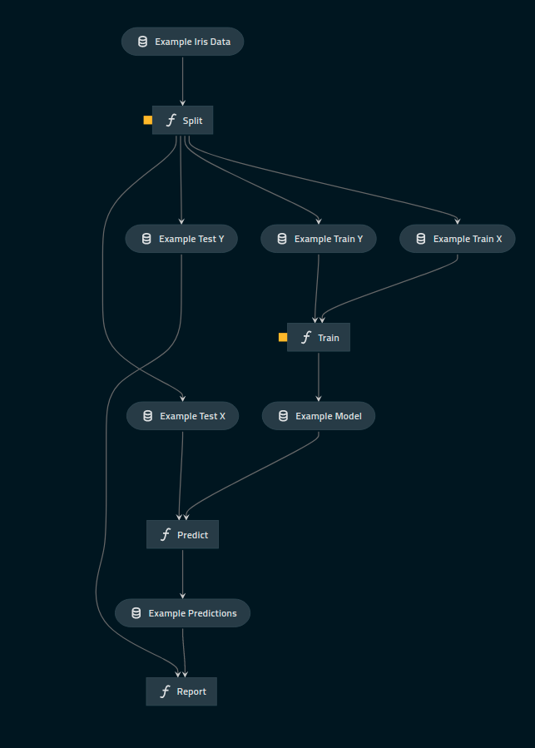
That’s often visualised in an ML pipeline

Slide 20
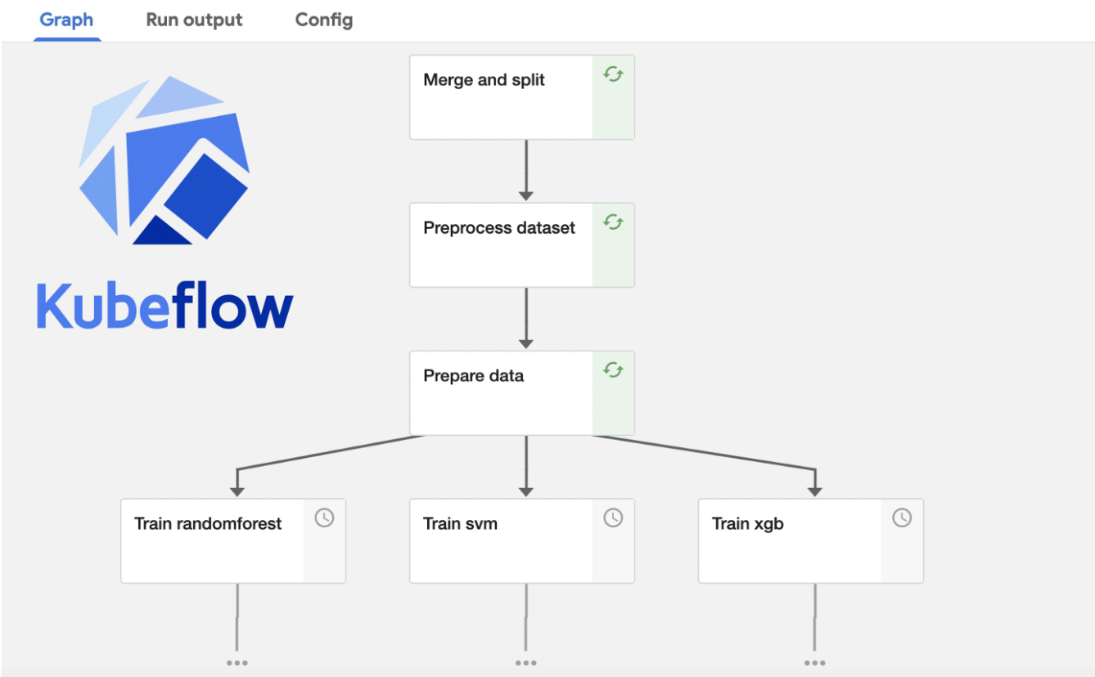
That’s often visualised in an ML pipeline

Slide 21
The whole proces is supported by repositories and CI/CD systems
Feature store
Experiment tracking
Model registry
Raw data
Data extraction and analysis
Data preparation
Model training
Model evaluation and validation
Trained model
Infrastructure monitoring
Model monitoring
CI/CD

Slide 22
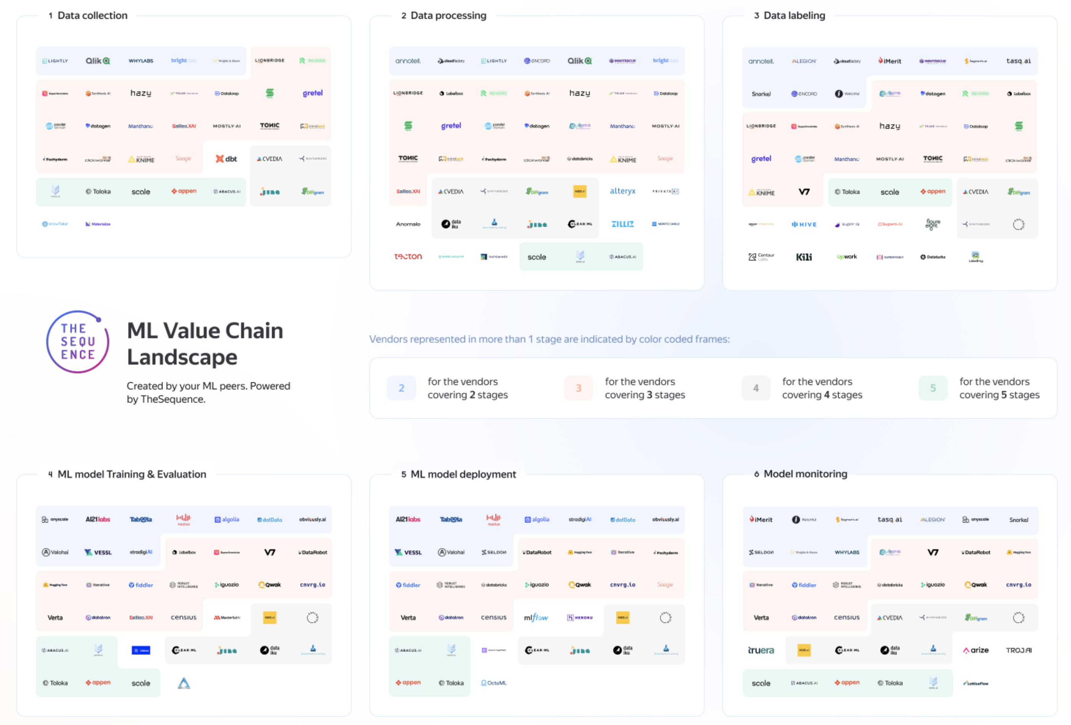

Slide 23
So, at the end of the day, we end up with a whole bunch of methods and tools…

Slide 24
1
Always be aware of Your place on the landscape. What are you working on?
As an AI Architect…
2
Start with absolute minimum: the simplest dataset, the simplest tools, the minimal number of steps…
Add extra complications in case they add a real value. Make Your ML Pipeline scalable, automate for good, etc.
3

Slide 25
Dive In
Model Development

Slide 26
01
Deploy
Develop
02
03
Monitor

Slide 27
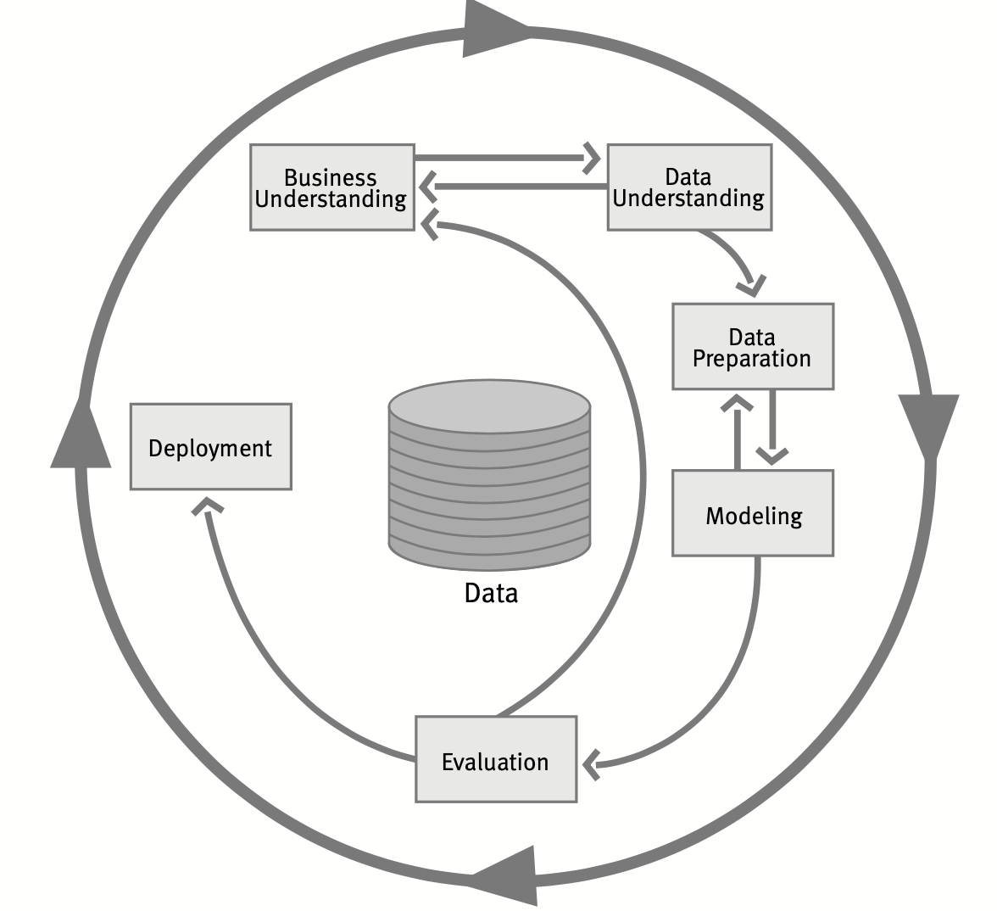
CRISP-DM
20 years old, but works ☺

Slide 28
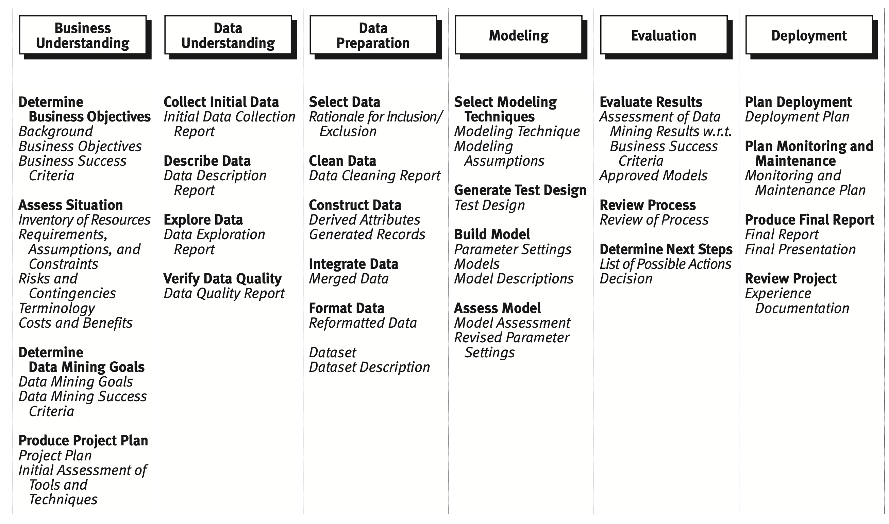

Slide 29
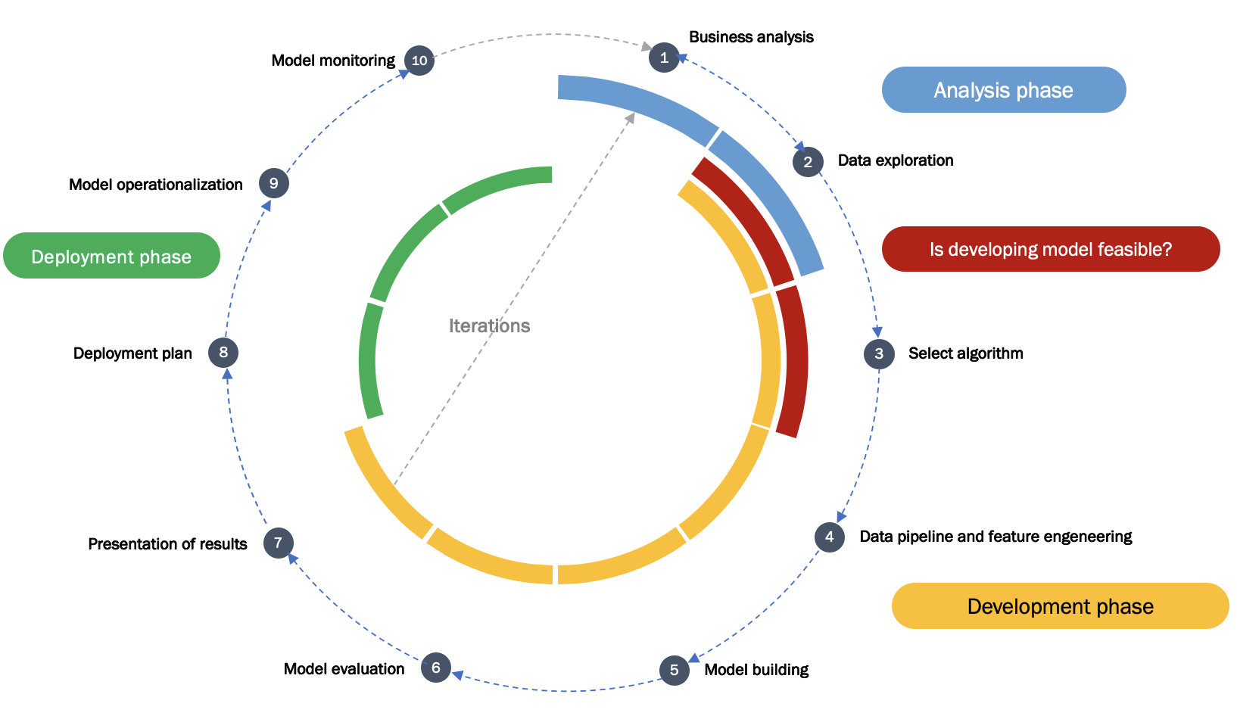
A bit more agile version

Slide 30
Business analysis
Model monitoring
10
1
Analysis phase
2
Data exploration
Model operationalization
9
Deployment phase
Is developing model feasible?
Iterations
Deployment plan
8
3
Select algorithm
Presentation of results
7
4
Data pipeline and feature engeneering
Development phase
Model evaluation
6
5
Model building

Slide 31
Problem definition
Data Preparation
Modeling
In general, there are 3 stages in a typical Model Development phase

Slide 32
Problem definition
Data Preparation
Modeling
In general, there are 3 stages in a typical Model Development phase

Slide 33
What is our primary goal?
How will we measure our success?
What are the resources (data, time, people) needed?
Problem definition
Questions

Slide 34
Identify a business problem (not ML problem)
Brainstorm AI solution
Assess the feasibility and value of potential solutions
Determine milestones
Budget for resources
Problem definition
Phases

Slide 35
Business metrics (revenue, etc.)
ML metrics (accuracy, precision/recall, etc.)
Software metrics (latency, throughput, etc. given compute resources)
Resources needed (data, personnel, help from other teams)
Problem definition
Outcomes

Slide 36
Problem definition
Data Preparation
Modeling
In general, there are 3 stages in a typical Model Development phase

Slide 37
Problem definition
Data Preparation
Modeling
In general, there are 3 stages in a typical Model Development phase

Slide 38
Data source
Data ingestion
Data validation
Data transformation
Data preparation
Data extraction
Data validation
Data analysis
Data analysis
Data enrichment
Data cleansing
Data transformation
Feature engineering
Data splitting

Slide 39
Data preparation
Data preparation

Slide 40
Problem definition
Data Preparation
Modeling
In general, there are 3 stages in a typical Model Development phase

Slide 41
Problem definition
Data Preparation
Modeling
In general, there are 3 stages in a typical Model Development phase

Slide 42
Data prepared
Training
Evaluation
Validation
Training at scale
Modeling
Choosing the alg
Model evaluation
Model analysis
Data prep
Building the model
Model optimization
Model validation
Infrastructure prep
Model training
Training at scale

Slide 43
Modeling
Modeling

Slide 44
Dive In
Model Deployment and Monitoring

Slide 45
Data source
Data preparation
Modeling
Source repo
Source code

Slide 46
experimentation/dev/test
01
Deploy
Develop
02
This is a code ☺
03
Monitor
staging/preprod/prod
01
Deploy
So, we want to treat it in a DevOps way
Develop
02
03
Monitor

Slide 47
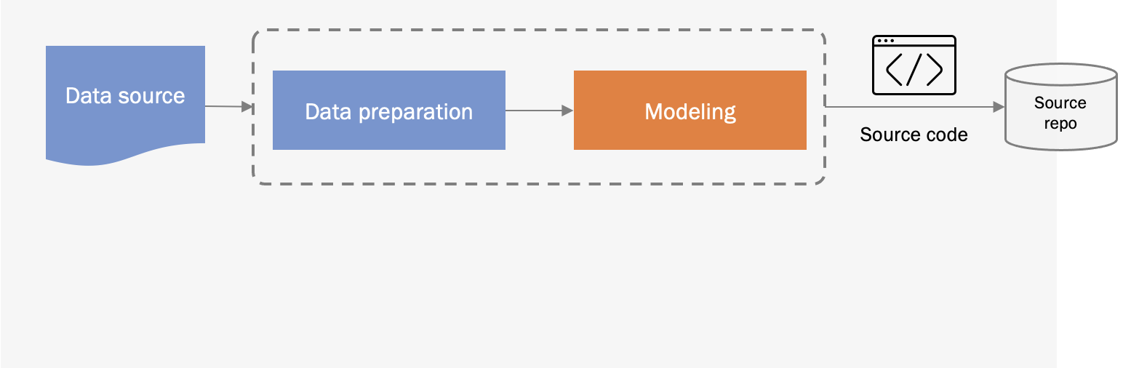
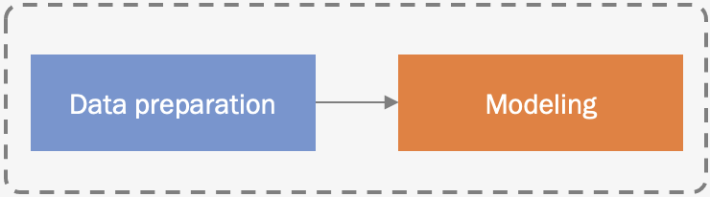
Model experimentation and development
CI/CD
Pipeline building and testing
Packages
CD Pipeline Deployment
Feature store
Model update cycle
Model serving
Continuous Deployment (CD)
Model repo
Data validation
Data preparation
Model serving
Scaling
Logging
Monitoring
Trigger
Model monitoring
Model API
Live data

Slide 48
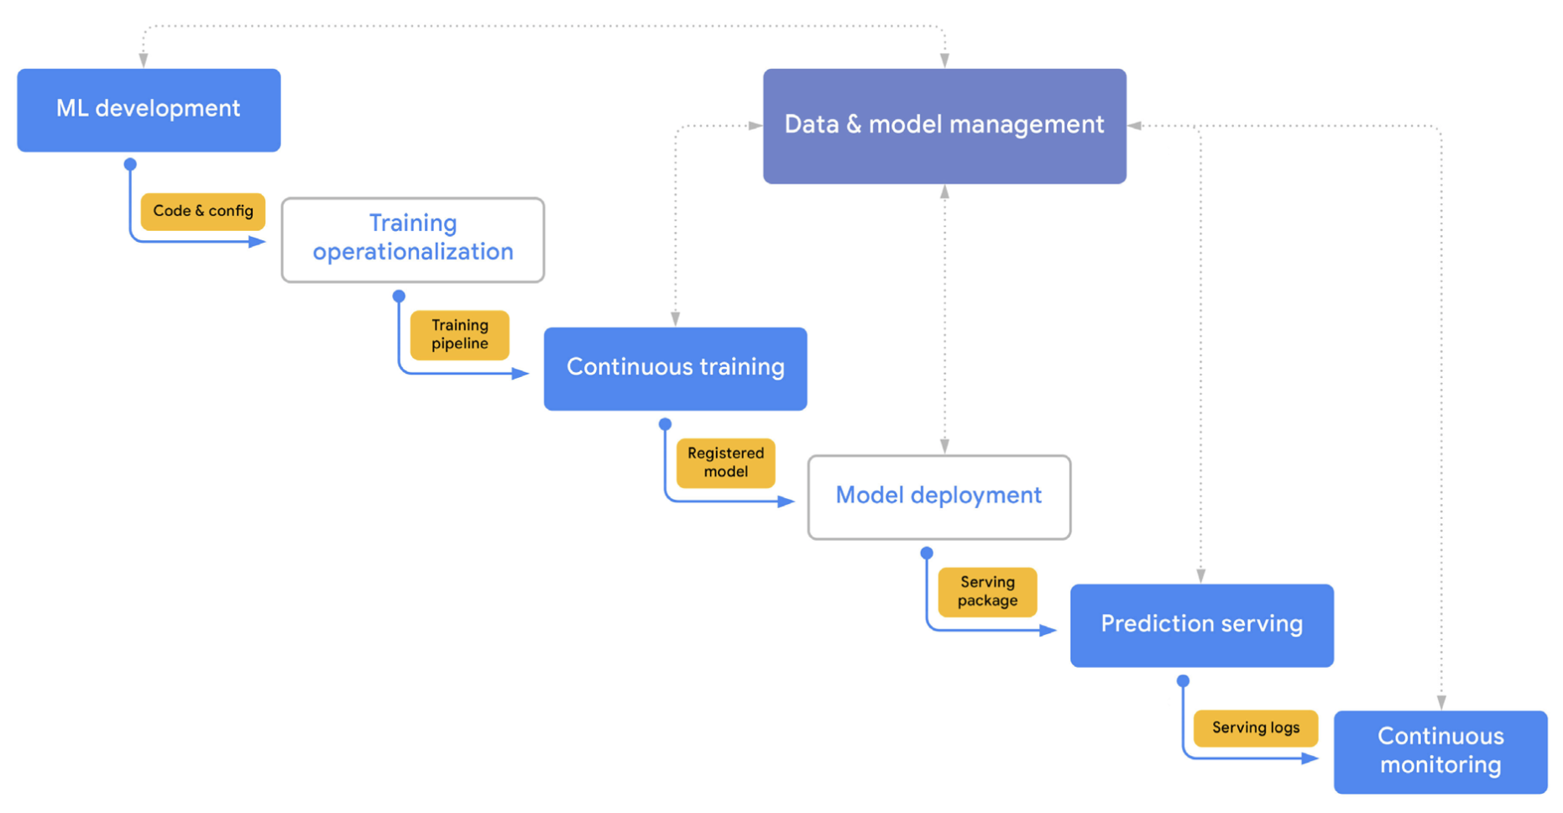
Another nice approach
Components and artifacts nicely separated
PBS <> WBS

Slide 49
Model experimentation and development
Data
Training
Code repo
CI/CD pipeline
But, at the end of the day…
Feature
store
Production
Training
Prediction service
Model repo
Trigger
Model monitoring
Live data

Slide 50
Set up an account on Google Cloud
Create a new project, e.g. asi23
Launch the simplest virtual machine (ubuntu) (@Compute Engine > VM Instances) Note: Pay special attention to the region selection (they differ, especially in available services). My recommendation: europe-west4
Install CLI (Command Line Interface) Client
Create a command that allows you to start and stop this machine from the CLI.
@home_1

Slide 51
Collect data from https://console.cloud.google.com/marketplace/product/iowa-department-of-commerce/iowa-liquor-sales and store it into Your Data Bucket
Read the data from the Bucket to a BQ Table in a dedicated BQ dataset
Create and run a SQL query to store a sample of this table in a dedcated table
Read this table into pandas dataframe
Study ML Sales Forecasting modeling where this dataset is used, e.g. https://victorjacobsen.com/?p=1368
@home_2

Slide 52
